Slide 1
Smoothed Mutual Information “Lower-bound” Estimator (SMILE) for Seizure Detection
April 19th , 2021
School of Biomedical Engineering
School of Biomedical Engineering

Slide 2

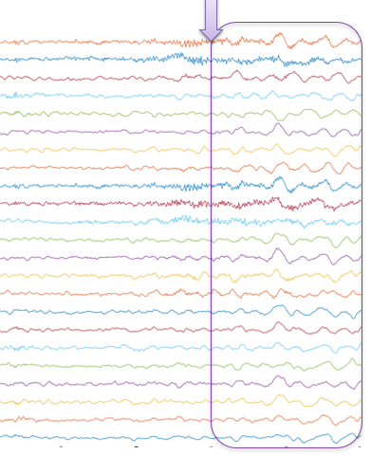
Mutual information:
Quantifies the dependence of two random variables X and Z:
In our case, dependency between each two channels
Ictal Block
School of Biomedical Engineering

Slide 3





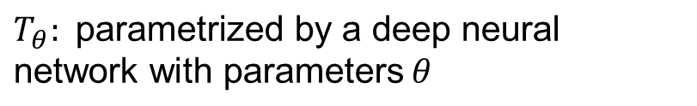
Mutual Information Neural Estimator (MINE)
Kullback-Leibler (KL) divergence :
The larger KL divergence, the stronger the dependence between X and Z
KL dual representation:
$$T_{θ}\text{: }\text{parametrized} \text{by} \text{a} \text{deep} \text{neural} \text{network} \text{with} \text{parameters} θ$$
School of Biomedical Engineering
School of Biomedical Engineering

Slide 4


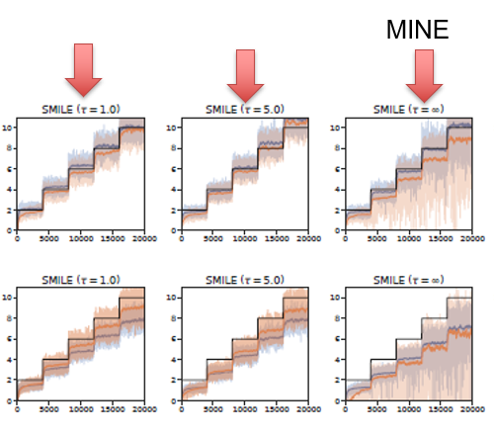
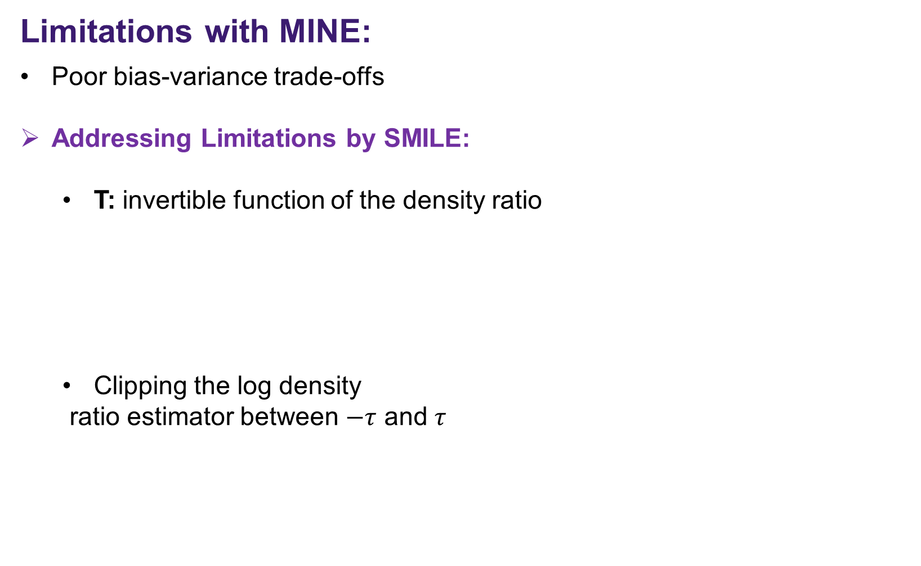
Limitations with MINE:
Poor bias-variance trade-offs
Addressing Limitations by SMILE:
T: invertible function of the density ratio
Clipping the log density
ratio estimator between $−τ$ and $τ$
Unbiased mini-batch estimator
SMILE
MINE
High-variance reduction
School of Biomedical Engineering

Slide 5
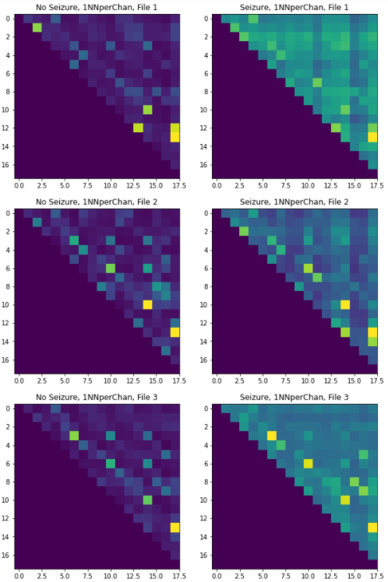
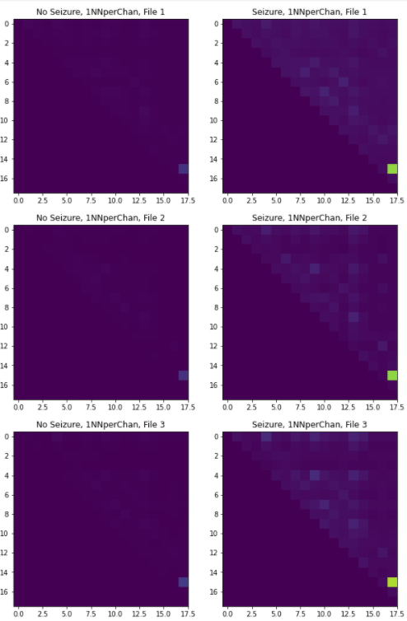
SMILE and KNN Results on EEG signals:
SMILE
KNN
(Pycit)
School of Biomedical Engineering
School of Biomedical Engineering

Slide 6
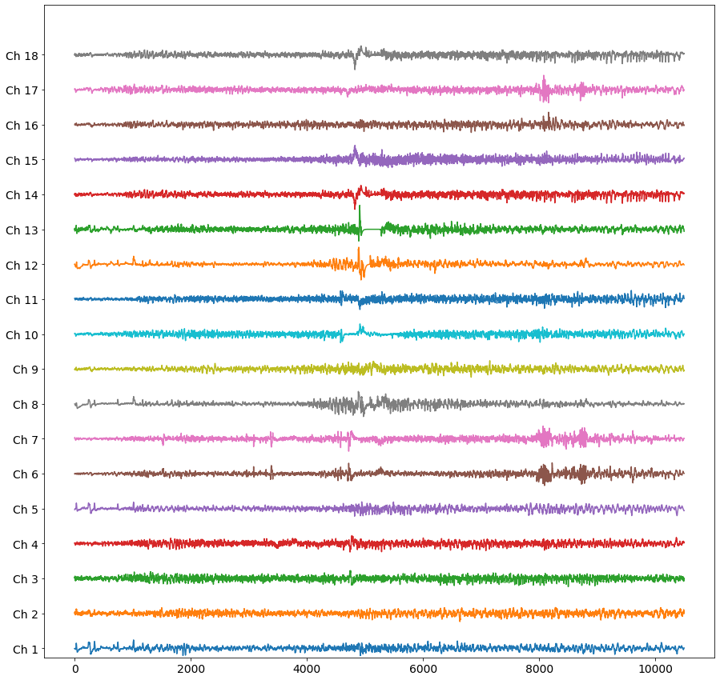
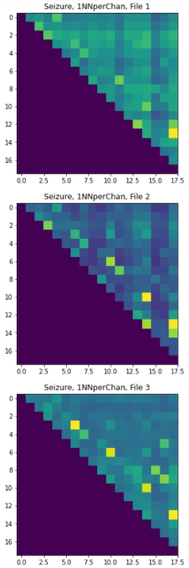
Results:
School of Biomedical Engineering

Slide 7
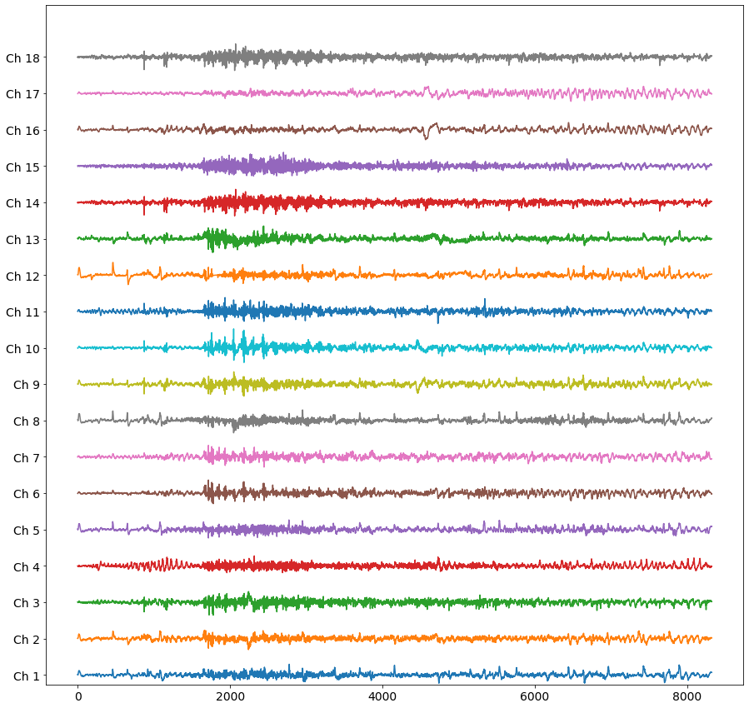
Results:
School of Biomedical Engineering

Slide 8
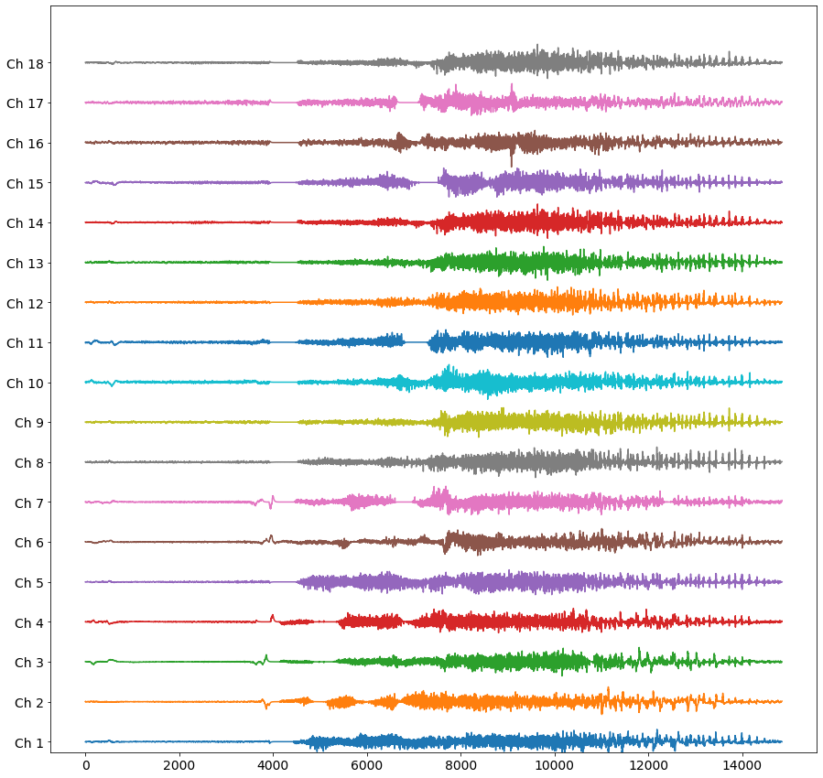
Results:
School of Biomedical Engineering

